Slide 1
Warming-up to Machine Learning, Data and Features
CSN-382

Slide 2
Plan for today
Types of ML problems
Typical workflow of ML problems
Various perspectives of ML problems
Data and Features
Some basic operations of data and features

Slide 3

Keep in mind: ML is like an exam
It’s the performance on the D-day which matters
In an exam, our success is measured based on how well we did on the questions in the test (not on the questions we practiced on)
Likewise, in ML, success of the learned model is measured based on how well it predicts/fits the future test data (not the training data)
Plus, of course, issues such as fairness
In Machine Learning, generalization performance
on the test data matters

Slide 4
A Loose Taxonomy of ML
“Labeled” means, during training, for each input, the corresponding output is available (i.e., the machine learner is explicitly told that a cat image is of a cat)
Learning using labeled data
Learning using unlabeled data
Some examples of
supervised learning problems
Classification
Regression
Ranking
Supervised
Learning
Unsupervised
Learning
Some examples of
unsupervised learning problems
Clustering
Dimensionality Reduction
Unsupervised Probability Density Estimation
Machine Learning
Many other specialized flavors of ML also exist,
some of which include
Semi-supervised Learning
Active Learning
Transfer Learning
Multitask Learning
Imitation Learning (somewhat related to RL)
Zero-Shot Learning
Few-Shot Learning
Continual learning
RL doesn’t use “labeled” or
“unlabeled” data in the traditional sense! In RL, an agent learns via
its interactions with an environment
Reinforcement Learning

Slide 5
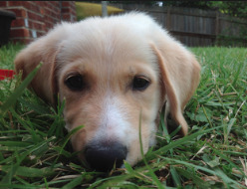
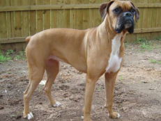
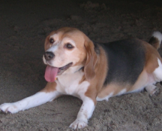
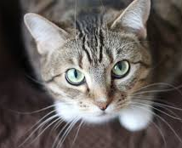
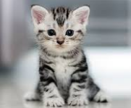
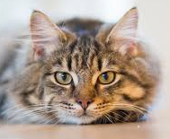

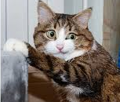
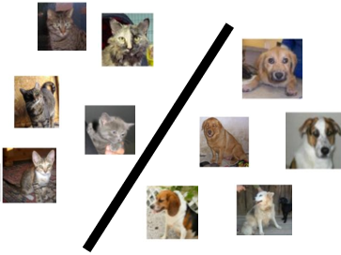
A Typical Supervised Learning Workflow
Note: This example is for the problem of binary classification, a supervised learning problem
Labeled
Training
Data
“dog”
“dog”
“dog”
“dog”
“dog”
Is feature extraction done “manually” as a pre-processing step before the ML algo starts working? Can’t we “automate” this part? Can’t we “learn” good features directly from raw inputs?
“cat”
“dog”
“cat”
“Feature”
Extraction
“cat”
ML Algorithm
(outputs a “model”)
“cat”
“cat”
“cat”
Feature extraction converts raw inputs to a numeric representation that the ML algo can understand and work with. More on feature extraction later.
Predicted Label
(cat/dog)
Test
Image
“Feature”
Extraction
Indeed. Deep Learning algos do precisely that!
(feature + model learning). More on Deep Learning later.
Cat vs Dog
Prediction model
https://www.pinclipart.com/, http://www.pngtree.com

Slide 6
A Typical Unsupervised Learning Workflow
Note: This example is for the problem of data clustering, an unsupervised learning problem
Unlabeled
Data
Yes. In this example, given a new “test” cat/dog image, we can assign it to the cluster with closer centroid
“Feature”
Extraction
ML Algorithm
(outputs a clustering)
Does unsupervised learning also have a test phase? That is, can we also predict the cluster of a new test input?
https://www.pinclipart.com/, http://www.pngtree.com
Notes:
Clustering indeed have a test phase.

Slide 7
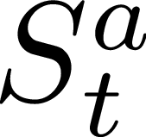

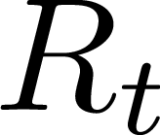
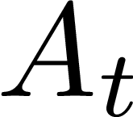
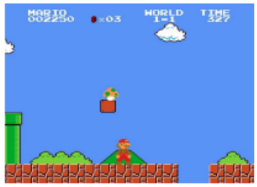
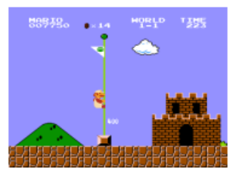
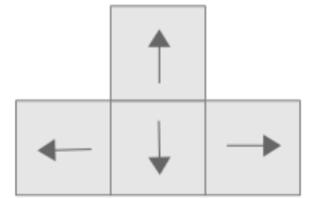

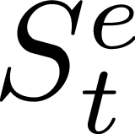
A Typical Reinforcement Learning Workflow
Wish to teach an agent optimal policy for some task
Agent does the following repeatedly
Senses/observes the environment
Takes an action based on its current policy
Receives a reward for that action
Updates its policy
Agent’s goal is to maximize its overall reward
Agent State
Observation
Reward
Action
There IS supervision, not explicit (as in Supervised Learning) but rather implicit (feedback based)
Environment State at time t

Slide 8
ML: Some Perspectives

Slide 9
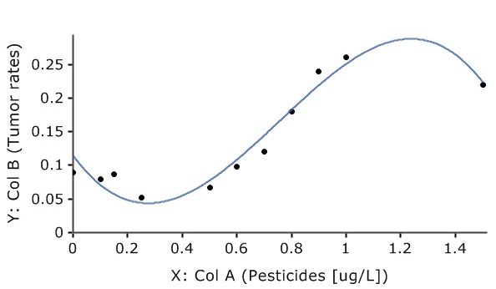
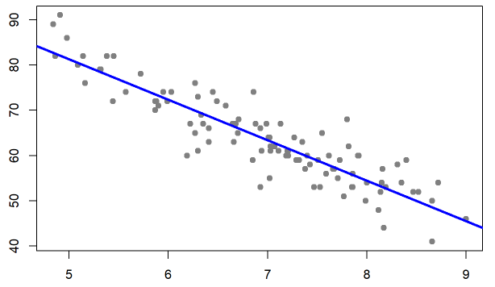
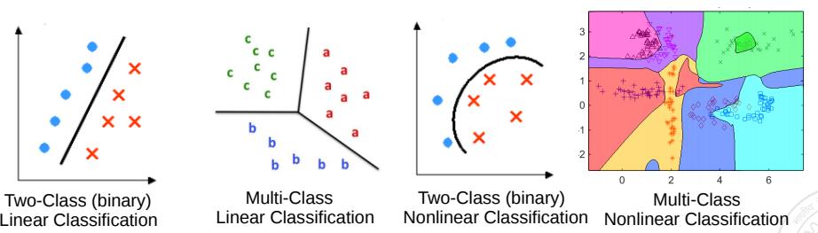
Geometric Perspective
Recall that feature extraction converts inputs into a numeric representation
Basic fact: Inputs in ML problems can often be represented as points or vectors in some vector space
Doing ML on such data can thus be seen from a geometric view
Regression: A supervised learning problem. Goal is to model the relationship between input (x) and real-valued output (y). This is akin to a line or curve fitting problem
y: Grumpiness (scale of 0-100)
x: sleep hours
Classification: A supervised learning problem. Goal is to learn a to predict which of the two or more classes an input belongs to. Akin to learning linear/nonlinear separator for the inputs
Pic from: https://learningstatisticswithr.com/book/regression.html, https://maxstat.de/

Slide 10
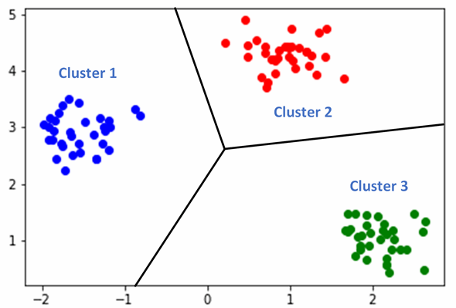
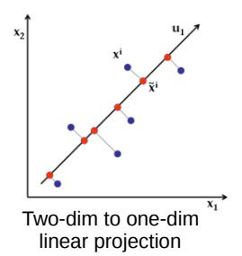
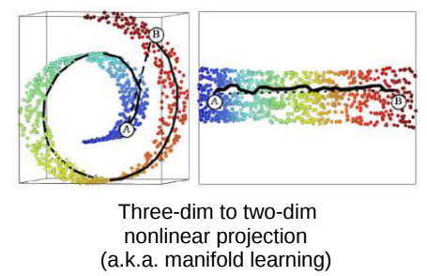
Geometric Perspective
Clustering looks like classification to me. Is there any difference?
Clustering: An unsupervised learning problem. Goal is to group inputs in a few clusters based on their similarities with each other
Yes. In clustering, we don’t know the labels. Goal is to separate them without any labeled “supervision”
Dimensionality Reduction: An unsupervised learning problem. Goal is to compress the size of each input without losing much information present in the data

Slide 11
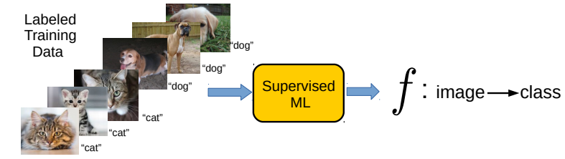
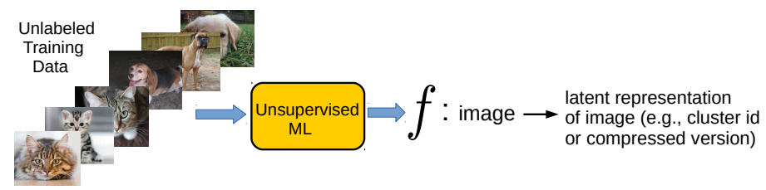
Perspective as function approximation
Supervised Learning (“predict output given input”) can be usually thought of as learning a function f that maps each input to the corresponding output
Unsupervised Learning (“model/compress inputs”) can also be usually thought of as learning a function f that maps each input to a compact representation
Reinforcement Learning can also be seen as doing function approximation
Harder since we don’t know the labels in this case

Slide 12
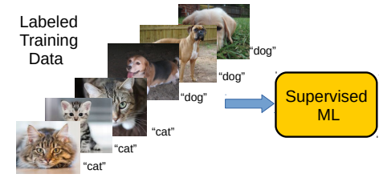
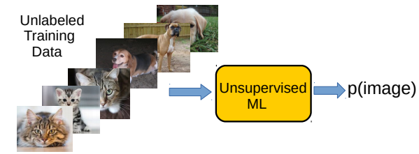
Perspective as probability estimation
Supervised Learning (“predict output given input”) can be thought of as estimating the conditional probability of each possible output given an input
Unsupervised Learning (“model/compress inputs”) can be thought of as estimating the probability density of the inputs
Reinforcement Learning can also be seen as estimating probability densities
p(label=“cat” | image)
Don’t worry if this doesn’t make much sense as of now ☺ But the basic idea is to learn the underlying data distribution using the unlabeled inputs; many ways to do this as we will see later
Harder since we don’t know the labels in this case

Slide 13
Data and Features

Slide 14
Data and Features
Features represent semantics of the inputs. Being able to extract good features is key to the success of ML algos
ML algos require a numeric feature representation of the inputs
Features can be obtained using one of the two approaches
Approach 1: Extracting/constructing features manually from raw inputs
Approach 2: Learning the features from raw inputs
Approach 1 is what we will focus on primarily for now
Approach 2 is what is followed in Deep Learning algorithms (will see later)
Approach 1 is not as powerful as Approach 2 but still used widely

Slide 15
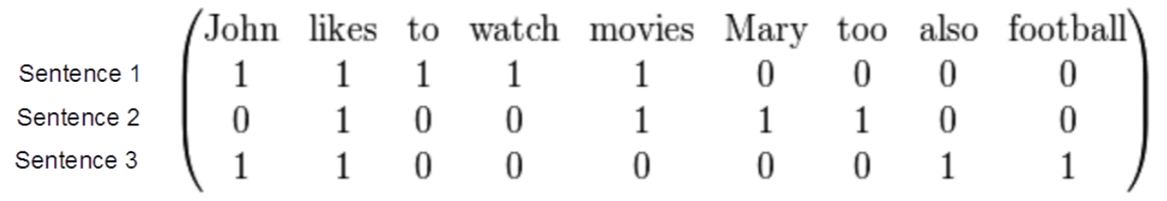
Example: Feature Extraction for Text Data
Consider some text data consisting of the following sentences:
John likes to watch movies
Mary likes movies too
John also likes football
Want to construct a feature representation for these sentences
Here is a “bag-of-words” (BoW) feature representation of these sentences
Each sentence is now represented as a binary vector (each feature is a binary value, denoting presence or absence of a word). BoW is also called “unigram” rep.
BoW is just one of the many ways of doing feature extraction for text data. Not the most optimal one, and has various flaws (can you think of some?), but often works reasonably well

Slide 16
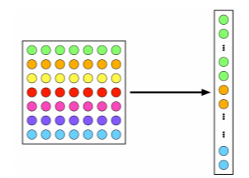

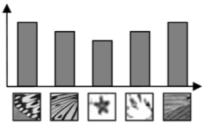
Example: Feature Extraction for Image Data
A very simple feature extraction approach for image data is flattening
Histogram of visual patterns is another popular feature extr. method for images
Many other manual feature extraction techniques developed in computer vision and image processing communities (SIFT, HoG, and others)
Flattening and histogram based methods destroy the spatial information in the image but often still work reasonably well
7x7 image
(49 pixels)
Vector of pixel
intensities
Pic credit: cat.uab.cat/Research/object-recognition

Slide 17
Feature Selection
Not all the extracted features may be relevant for learning the model (some may even confuse the learner)
Feature selection (a step after feature extraction) can be used to identify the features that matter, and discard the others, for more effective learning
Many techniques exist – some based on intuition, some based on algorithmic principles (will visit feature selection later)
More common in supervised learning but can also be done for unsup. learning
Age
Gender
Height
Weight
Eye color
Calculating BMI from this data doesn’t require ML but this simple example is just to illustrate the idea of feature selection ☺
Body-mass index (BMI)

Slide 18
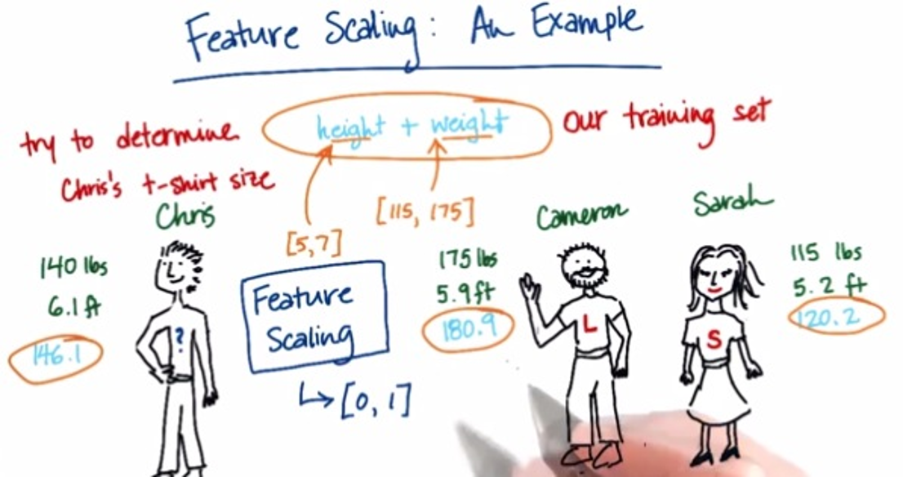
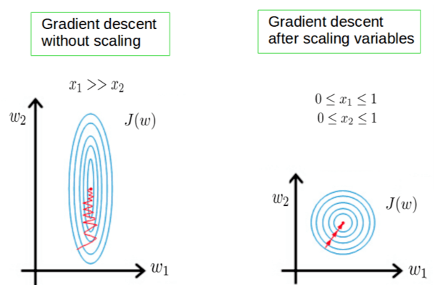
Some More Postprocessing: Feature Scaling
Even after feature selection, the features may not be on the same scale
This can be problematic when comparing two inputs – features that have larger scales may dominate the result of such comparisons
Therefore helpful to standardize the features (e.g., by bringing all of them on the same scale such as between 0 to 1)
Also helpful for stabilizing the optimization techniques used in ML algos
Pic credit: https://becominghuman.ai/demystifying-feature-scaling-baff53e9b3fd, https://stackoverflow.com/
Notes:
Importance of feature scaling
Numerically Stabilize training by bringing all the inputs to same scale such as between 0 and 1.
Prevents bias => it ensures that all features contribute equally to the model's calculations, preventing features with larger scales from dominating the learning process.
Enhance interpretability and compare => Scaled features make it easier to interpret the coefficients or weights of the model, as they are on a comparable scale.
Some algorithms, like k-NN and SVM, are more sensitive to the scale of the data and require features to be on a similar scale for effective performance.
When the features are scaled several machine learning methods including gradient descent-based algorithms, distance-based algorithms (such k-nearest neighbors) and support vector machines perform better or converge more quickly.
Scaling features makes sure that each characteristic is given the same consideration during the learning process.

Slide 19
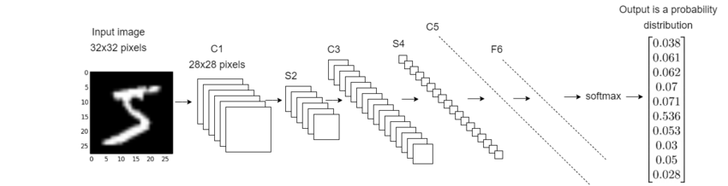
Deep Learning: An End-to-End Approach to ML
Deep Learning = ML with automated feature learning from the raw inputs
Feature extraction part is automated via the feature learning module
Classification Model Learning
Feature Learning Module
(one or more layers_
Raw Input
Learned Features
(penultimate layer)
Pic an adaptation of the original from: https://deepai.org/

Slide 20
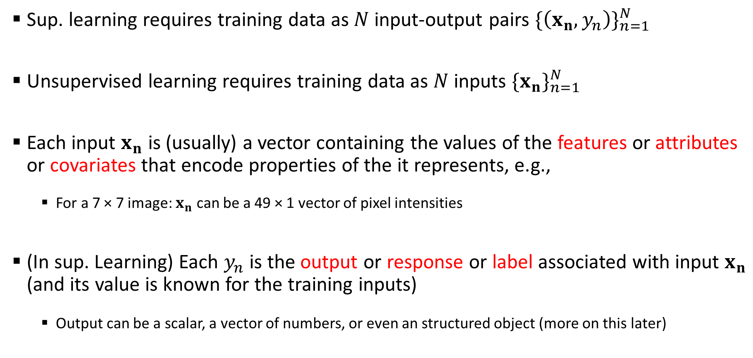
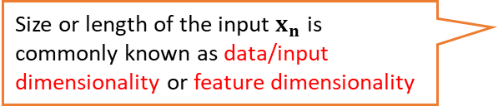
Some Notation/Nomenclature/Convention
Sup. learning requires training data as $N$ input-output pairs ${\{\left(x_{n},y_{n}\right)\}}_{n=1}^{N}$
Unsupervised learning requires training data as $N$ inputs ${\{x_{n}\}}_{n=1}^{N}$
Each input $x_{n}$ is (usually) a vector containing the values of the features or attributes or covariates that encode properties of the it represents, e.g.,
For a 7 × 7 image: $x_{n}$ can be a 49 × 1 vector of pixel intensities
(In sup. Learning) Each $y_{n}$ is the output or response or label associated with input $x_{n}$ (and its value is known for the training inputs)
Output can be a scalar, a vector of numbers, or even an structured object (more on this later)
RL and other flavors of ML problems also use similar notation
Size or length of the input $x_{n}$ is commonly known as data/input dimensionality or feature dimensionality

Slide 21
Types of Features and Types of Outputs
Features as well as outputs can be real-valued, binary, categorical, ordinal, etc.
Real-valued: Pixel intensity, house area, house price, rainfall amount, temperature, etc
Binary: Male/female, adult/non-adult, or any yes/no or present/absent type value
Categorical/Discrete: Zipcode, blood-group, or any “one from a finite many choices“ value
Ordinal: Grade (A/B/C etc.) in a course, or any other type where relative values matter
Often, the features can be of mixed types (some real, some categorical, some ordinal, etc.)

Slide 22

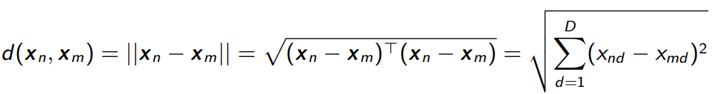
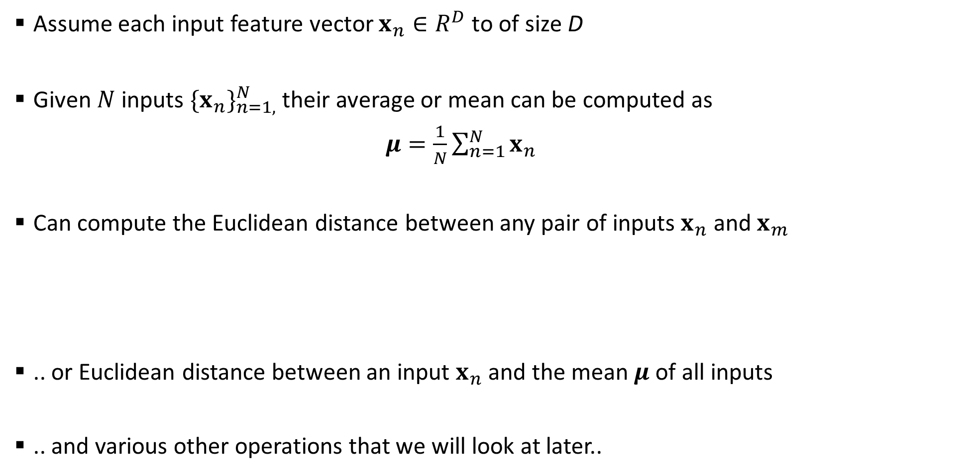
Some Basic Operations of Inputs
Assume each input feature vector $x_{n}∈R^{D}$ to of size D
Given $N$ inputs ${\{x_{n}\}}_{n=1,}^{N}$ their average or mean can be computed as
$μ=\frac{1}{N}\sum_{n=1}^{N}{x_{n}}$
Can compute the Euclidean distance between any pair of inputs $x_{n}$ and $x_{m}$
.. or Euclidean distance between an input $x_{n}$and the mean $μ$of all inputs
.. and various other operations that we will look at later..
What does such a “mean” represent?
If inputs are all cat images, mean vector would represents what an “average” cat looks like

